Slide 1
Feature modules
Hardeep Kaur Dhalla

Slide 2
Objectives
More about Services
Feature modules

Slide 3
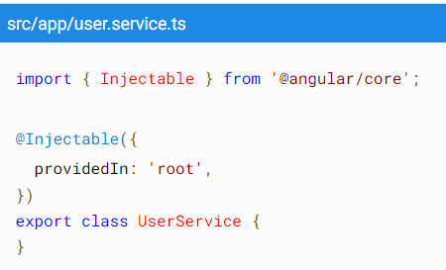
Services
A singleton service is a service for which only one instance exists in an application.
There are two ways to make a service a singleton in Angular:
Set the providedIn property of the @Injectable() to "root".
Include the service in the AppModule or in a module that is only imported by the AppModule.

Slide 4
Providers
In app.module.ts file
One way:
providers: [SimpleDataSource,
{ provide: LogService, useClass: LogService}]
Another way:
providers: [SimpleDataSource, LogService]

Slide 5
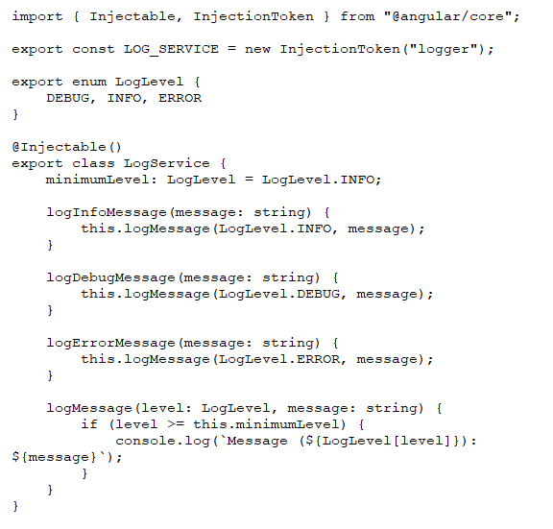
Services
@injectionToken – this class
Make sure unique tokens are
Created.

Slide 6
Feature modules
An angular application can have many features that are called modules.
Each module serves a block of single functionality.
Angular modules are used to group angular components that share similar functionality.
You can put commonly used directives, pipes, and components into one module and then import just that module wherever you need it in other parts of your application.

Slide 7
How to make a feature module?
In the project root directory execute following command
ng generate featureModuleName
Example: ng generate module CustomerDashboard
To add a component, enter the following command at the command line where customer-dashboard is the directory where the CLI generated the feature module and CustomerDashboard is the name of the component:
ng generate component customer-dashboard/CustomerDashboard

Slide 8
Importing a feature module
let the root module, app.module.ts, know about feature module.
Open app.module.ts in an editor and make changes to it.

Slide 9
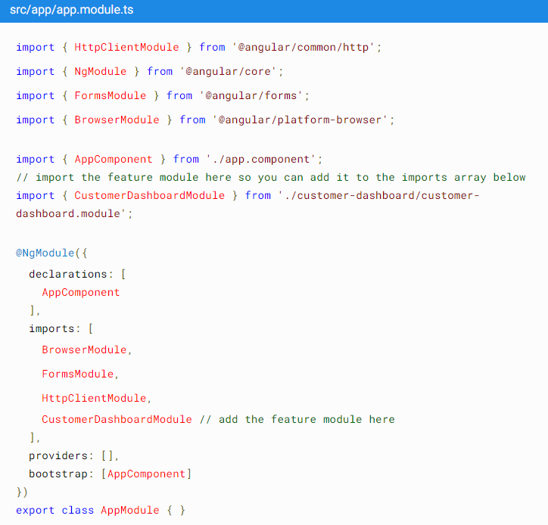

Slide 10
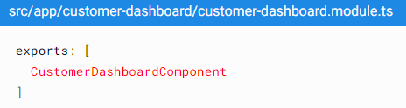
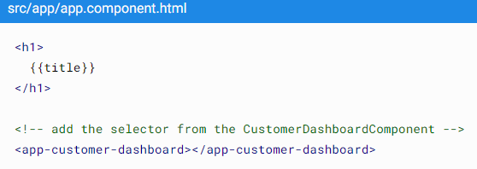
Rendering a feature module’s component template

Slide 11
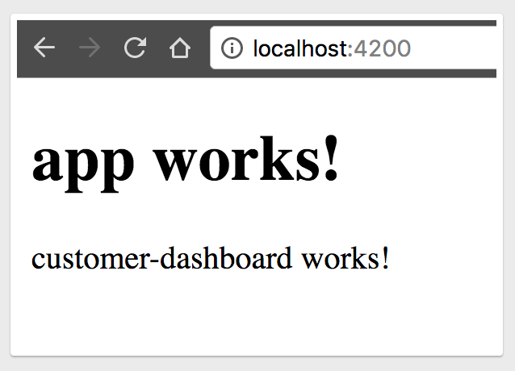
Expected output

Slide 12
References
https://angular.io/guide/feature-modules
https://angular.io/guide/module-types#service-ngmodules
https://angular.io/api/core/Inject
https://angular.io/api/core/InjectionToken#description

